Slide 1
Rocky Mountain National Park
Colorado
Notes:
The background is distracting, and the title is difficult to read.

Slide 2
Recreate Responsibly
Keep your distance. Consistent with CDC guidance regarding areas of substantial or high transmission, visitors, regardless of vaccination status, are required to wear a mask inside all park buildings.
Keep it with you. If you brought it, take it with you. Trash pickup and restroom facilities will continue to be limited in many park areas. Follow Leave No Trace principles.
Know your limits. Rocky Mountain National Park is one of the busiest search and rescue parks in the country. Many of these incidents could be avoided with visitors planning and making responsible decisions. It is critical to make wise choices to keep our national park rangers and first responders out of harm’s way.
Protect wildlife. Obey speed limits and be aware of wildlife.

Slide 3
Alerts in Effect
Closures due to Cameron Peak and East Troublesome Fires
This closure includes some roads, trail systems, wilderness campsites, and cross country zones.
Trail Ridge Road Status
Trail Ridge Road through the park is closed for the season to vehicles. Locations of closures will vary based on weather and road conditions.
Recorded status line (970) 586-1222

Slide 4
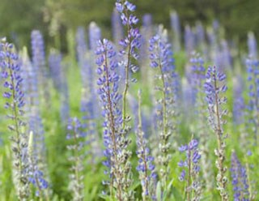
Mountain Lupine
Mountain lupine can reach a height of 1 to 3 ft. (40-100cm). The color of the petals can vary from creamy white to blue. The leaves are palmately compound with five or more leaflets.

Slide 5
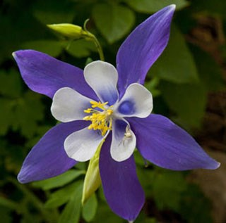
Columbine
Colorado columbine is the state flower of Colorado. The petals are drawn out into long spurs between the sepals. The spurs contain nectar, which attracts butterflies and long tongued bees. Colorado columbine begins blooming in June at lower elevations through August in alpine areas.
Notes:
The background is distracting

Slide 6
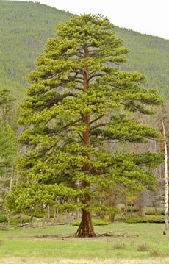
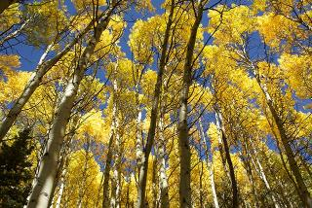
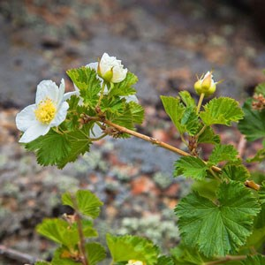
Common Woody Plants in the Park
Aspen
Boulder Raspberry
Ponderosa Pine
Notes:
Check the Reading Order

Slide 7
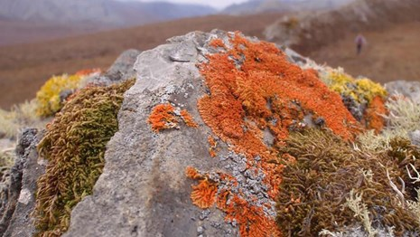
Lichens
Lichens can be challenging to identify.
Characters used for identification usually include color, texture, or growth form, and the form of the reproductive structures called apothecia.
Apothecia are usually small, rimmed cups or disks on the surface of the lichen.
Notes:
The picture animation is distracting.

Slide 8
Accessible Camping
Campground | Elevation (ft)
Aspenglen | 8,220
Longs Peak | 9,405
Moraine Park | 8,150
Timber Creek | 8,900
Accessible campsites available
No accessible campsites
Notes:
The table needs a header row. Information is conveyed by only using color.

Slide 9
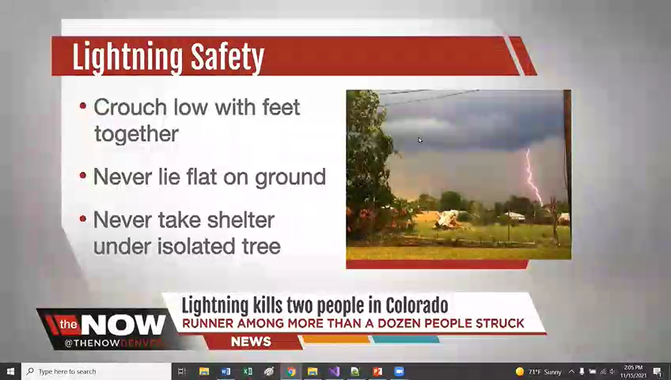
Lightning Safety
Lightning Safety News Link
Notes:
The video does have captions. It needs alt text.

Slide 10
For More Information
https://www.nps.gov/romo/index.htm
Notes:
Rewrite the link. Look at how distracting the transitions are.

